Slide 1


Introduction to Docker Compose

Slide 2
Agenda
What is Docker Compose?
3 Steps of Docker Compose
Building Blocks of Docker Compose
Docker Compose File Format
Networking in Docker Compose
Environmental Variable under Docker Compose
Installing Docker Compose
Examples – WordPress, HelloWhale etc.
Hands-on Labs

Slide 3
Did you know?
There are 3,00,000 Docker Compose files in GitHub today

Slide 4













Docker Compose: Multi Container Applications
Without Compose
Build and run one container at a time
Manually connect containers together
Must be careful with dependencies and start up order
With Compose
Define multi container app in compose.yml file
Single command to deploy entire app
Handles container dependencies
Works with Docker Swarm, Networking, Volumes, Universal Control Plane
4

Slide 5


Docker Compose: WordPress Application
Without Compose
With Compose
$docker run -e MYSQL_ROOT_PASSWORD=<pass> -e MYSQL_DATABASE=wordpress --name wordpressdb -v "$PWD/database":/var/lib/mysql -d mysql:latest
services:
db:
image: mysql:5.7 volumes:
- db_data:/var/lib/mysql environment: MYSQL_ROOT_PASSWORD:
MYSQL_DATABASE: wordpress wordpress:
depends_on:
- db
image: wordpress:latest ports:
- "80:80"
environment: WORDPRESS_DB_PASSWORD=<pass>
$docker run -e WORDPRESS_DB_PASSWORD=<pass> --name wordpress --link wordpressdb:mysql -p 80:80 -v "$PWD/html":/var/www/html
-d wordpress
5

Slide 6
What is Docker Compose?
A tool for defining and running multi- container Docker applications
With Compose, you use a YAML file to configure your application’s services.
Compose works in all environments: production, staging, development, testing, as well as CI workflows.
With a single command, you create and start all the services from your configuration

Slide 7

3 step process of Docker Compose

Slide 8

Docker Compose is a 3 Steps Process
Define your app’s environment with a Dockerfile
Define the services that make up your app in Docker Compose file
Run the CLI:
$ docker-compose up

Slide 9
Building Blocks of Docker Compose

Slide 10


Building Blocks of Docker Compose
A
B
C
Services
Volumes
Networking

Slide 11


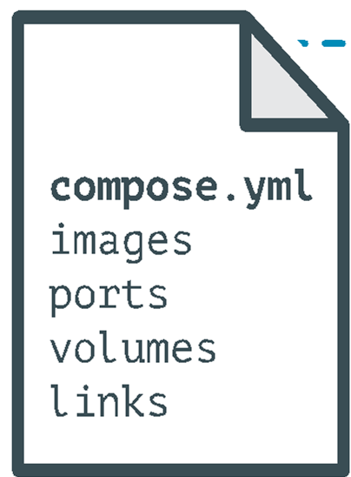
Docker Compose: Multi Container Applications
containers:
web:
build: .
command: python app.py
ports:
- "5000:5000"
Volumes:
-.:/code environment:
- PYTHONUNBUFFERED=1
redis:
image: redis:latest
command: redis-server --appendonly yes

Slide 12
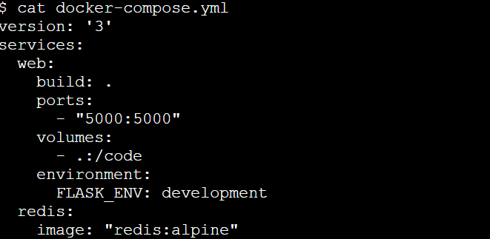
A Sample Docker Compose File

Slide 13
Environmental Variable in Docker Compose

Slide 14
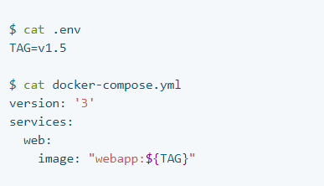
Environmental Variable in Docker Compose:
Using .env file

Slide 15
Environmental Variable in Docker Compose:
Using `docker-compose run` command

Slide 16
Networking in Compose

Slide 17
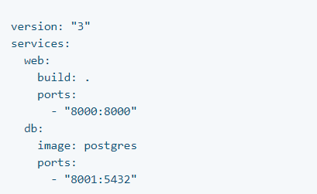
Networking in Compose
A network called myapp_default is created.
A container is created using web’s configuration.
It joins the network myapp_default under the
name web.
A container is created using db’s configuration. It
joins the network myapp_default under the
name db.

Slide 18
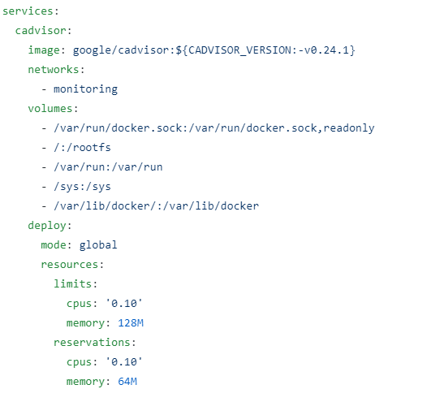
Compose for Swarm Mode
The same Compose file can be used to deploy containerized apps on multi-host system
The overlay driver creates a named network
across multiple nodes in a swarm.
The “global mode” enable atleast one copy of
apps running on every node of the swarm

Slide 19
How to install Docker Compose?

Slide 20
How to Install Docker Compose
$ curl -L https://github.com/docker/compose/releases/download/v5.0.2/docker-compose-linux-x86_64 -o /usr/local/bin/docker-compose
$ chmod +x /usr/local/bin/docker-compose
Note: Docker Desktop will automatically install the latest version of Docker Engine for you.

Slide 21
A Sample WordPress Compose File

Slide 22
